Slide 1
JavaScript
Instructor
Mahamudul Hasan

Slide 2
Why JavaScript?
JavaScript is one of 3 languages all web developers MUST learn:
HTML to define the content of web pages
CSS to specify the layout of web pages
JavaScript to program the behavior of web pages

Slide 3
What JavaScript can do?
JavaScript Can Change HTML Elements
JavaScript Can Change HTML Attributes
JavaScript Can Change HTML Styles (CSS)
JavaScript Can Validate Data

Slide 4
The <script> tag
<!DOCTYPE html> <html> <body> <h1>My Web Page</h1> <p id="demo">A Paragraph</p> <button type="button" onclick="myFunction()">Try it</button> <script> function myFunction() { document.getElementById("demo").innerHTML = "Paragraph changed."; } </script> </body> </html>

Slide 5
External JavaScripts
Scripts can also be placed in external files.
External scripts are practical when the same code is used in many different web pages.
JavaScript files have the file extension .js.
To use an external script, put the name of the script file in the source (src) attribute of the <script> tag:
Example
<!DOCTYPE html> <html> <body> <script src="myScript.js"></script> </body> </html>

Slide 6
JavaScript accepts both double and single quotes:
<!DOCTYPE html>
<html>
<body>
<h2>What Can JavaScript Do?</h2>
<p id="demo">JavaScript can change HTML content.</p>
<button type="button" onclick="document.getElementById('demo').innerHTML = 'Hello JavaScript!'">Click Me!</button>
</body>
</html>

Slide 7
JavaScript Can Change HTML Attribute Values
<!DOCTYPE html>
<html>
<body>
<h2>What Can JavaScript Do?</h2>
<p>JavaScript can change HTML attribute values.</p>
<p>In this case JavaScript changes the value of the src (source) attribute of an image.</p>
<button onclick="document.getElementById('myImage').src='pic_bulbon.gif'">Turn on the light</button>
<img id="myImage" src="pic_bulboff.gif" style="width:100px">
<button onclick="document.getElementById('myImage').src='pic_bulboff.gif'">Turn off the light</button>
</body>
</html>

Slide 8
JavaScript Can Change HTML Styles (CSS)
<!DOCTYPE html>
<html>
<body>
<h2>What Can JavaScript Do?</h2>
<p id="demo">JavaScript can change the style of an HTML element.</p>
<button type="button" onclick="document.getElementById('demo').style.fontSize='35px'">Click Me!</button>
</body>
</html>

Slide 9
JavaScript Can Hide HTML Elements
<!DOCTYPE html>
<html>
<body>
<h2>What Can JavaScript Do?</h2>
<p id="demo">JavaScript can hide HTML elements.</p>
<button type="button" onclick="document.getElementById('demo').style.display='none'">Click Me!</button>
</body>
</html>

Slide 10
JavaScript Can Show HTML Elements
<!DOCTYPE html>
<html>
<body>
<h2>What Can JavaScript Do?</h2>
<p>JavaScript can show hidden HTML elements.</p>
<p id="demo" style="display:none">Hello JavaScript!</p>
<button type="button" onclick="document.getElementById('demo').style.display='block'">Click Me!</button>
</body>
</html>

Slide 11
JavaScript Where To
The <script> Tag
In HTML, JavaScript code must be inserted between <script> and </script> tags.
Old JavaScript examples may use a type attribute: <script type="text/javascript">. The type attribute is not required. JavaScript is the default scripting language in HTML.

Slide 12
JavaScript Functions and Events
A JavaScript function is a block of JavaScript code, that can be executed when "called" for.
For example, a function can be called when an event occurs, like when the user clicks a button.

Slide 13
JavaScript in <head> or <body>
You can place any number of scripts in an HTML document.
Scripts can be placed in the <body>, or in the <head> section of an HTML page, or in both.

Slide 14
JavaScript in <head>
<!DOCTYPE html>
<html>
<head>
<script>
function myFunction() {
document.getElementById("demo").innerHTML = "Paragraph changed.";
}
</script>
</head>
<body>
<h2>JavaScript in Head</h2>
<p id="demo">A Paragraph.</p>
<button type="button" onclick="myFunction()">Try it</button>
</body>
</html>

Slide 15
JavaScript in <body>
<!DOCTYPE html>
<html>
<body>
<h2>JavaScript in Body</h2>
<p id="demo">A Paragraph.</p>
<button type="button" onclick="myFunction()">Try it</button>
<script>
function myFunction() {
document.getElementById("demo").innerHTML = "Paragraph changed.";
}
</script>
</body>
</html>

Slide 16
External JavaScript
External scripts are practical when the same code is used in many different web pages.
JavaScript files have the file extension .js.
To use an external script, put the name of the script file in the src (source) attribute of a <script> tag:
<script src="myScript.js"></script>
You can place an external script reference in <head> or <body> as you like.
The script will behave as if it was located exactly where the <script> tag is located.
External scripts cannot contain <script> tags.

Slide 17
External JavaScript Advantages
Placing scripts in external files has some advantages:
It separates HTML and code
It makes HTML and JavaScript easier to read and maintain
Cached JavaScript files can speed up page loads
To add several script files to one page - use several script tags:
Example
<script src="myScript1.js"></script> <script src="myScript2.js"></script>

Slide 18
External References
External scripts can be referenced with a full URL or with a path relative to the current web page.
This example uses a full URL to link to a script:
Example
<script src="https://www.helloworld.com/js/myScript1.js"></script>
This example uses a script located in a specified folder on the current web site:
Example
<script src="/js/myScript1.js"></script>

Slide 19
JavaScript Output
JavaScript Display Possibilities
JavaScript can "display" data in different ways:
Writing into an HTML element, using innerHTML.
Writing into the HTML output using document.write().
Writing into an alert box, using window.alert().
Writing into the browser console, using console.log().

Slide 20
Using innerHTML
To access an HTML element, JavaScript can use the document.getElementById(id) method.
The id attribute defines the HTML element. The innerHTML property defines the HTML content:

Slide 21
Using innerHTML
<!DOCTYPE html>
<html>
<body>
<h2>My First Web Page</h2>
<p>My First Paragraph.</p>
<p id="demo"></p>
<script>
document.getElementById("demo").innerHTML = 5 + 6;
</script>
</body>
</html>

Slide 22
Using document.write()
For testing purposes, it is convenient to use document.write():
<!DOCTYPE html>
<html>
<body>
<h2>My First Web Page</h2>
<p>My first paragraph.</p>
<p>Never call document.write after the document has finished loading.
It will overwrite the whole document.</p>
<script>
document.write(5 + 6);
</script>
</body>
</html>

Slide 23
Using document.write() after an HTML document is loaded, will delete all existing HTML:
<!DOCTYPE html>
<html>
<body>
<h2>My First Web Page</h2>
<p>My first paragraph.</p>
<button type="button" onclick="document.write(5 + 6)">Try it</button>
</body>
</html>

Slide 24
Using window.alert()
<!DOCTYPE html>
<html>
<body>
<h2>My First Web Page</h2>
<p>My first paragraph.</p>
<script>
window.alert(5 + 6);
</script>
</body>
</html>

Slide 25
Using console.log()
For debugging purposes, you can use the console.log() method to display data.
<!DOCTYPE html>
<html>
<body>
<h2>Activate debugging with F12</h2>
<p>Select "Console" in the debugger menu. Then click Run again.</p>
<script>
console.log(5 + 6);
</script>
</body>
</html>

Slide 26
JavaScript Output
Manipulating HTML Elements
To access an HTML element from JavaScript, you can use the document.getElementById(id) method.
Use the "id" attribute to identify the HTML element, and innerHTML to refer to the element content:
Writing to the HTML Document
<script> document.write(Date()); </script>

Slide 27
JavaScript Literals
Number literals can be written with or without decimals, and with or without scientific notation (e): 3.14, 1001, 123e5
String literals can be written with double or single quotes: “John Snow”, ‘John Snow’
Expression literals evaluates (computes) to a value: 5+6, 5*6
Array literals defines an array: [40, 100, 1, 5, 25, 10]
Object literals defines an object: {firstName:"John", lastName:“Snow", age:20, eyeColor:"blue"}
Function literals defines a function: function myFunction(a, b) { return a * b;}

Slide 28
JavaScript Variables
In a programming language, named variables stores data values.
JavaScript uses the var keyword to define variables, and an equal sign to assign values to variables (just like algebra):
var x, length x = 5 length = 6

Slide 29
JavaScript Data types
var length = 16; // Number assigned by a number literal
var points = x * 10; // Number assigned by an expression literal
var lastName = "Johnson"; // String assigned by a string literal
var cars = ["Saab", "Volvo", "BMW"]; // Array assigned by an array literal
var person = {firstName:”John”, lastName:”Snow”}; // Object assigned by an object literal

Slide 30
JavaScript Function
JavaScript statements written inside a function, can be invoked many times (reused):
Invoke a function = Call upon a function (ask for the code in the function to be executed).
function myFunction(a, b) { return a * b; // returns the product of a and b }

Slide 31
JavaScript Strings
Strings can be objects.
var x = "John"; var y = new String("John");

Slide 32
Useful String Methods
var str = “ ………………………”;
Finding a string in a string → str.indexOf(“…….”); str.lastIndexOf(“………”);
Searching for string content → str.search(“………");
Extracting Strings → str.slice(start, end); str.substr(start, length);
Replacing Content → str.replace(“old”,”new”);
Converting upper and lower case → str.toUpperCase(); str.toLowerCase();
Converting a string to an Array → str.split(“,”);

Slide 33
JavaScript Numbers
JS Numbers are always 64-bit floating point numbers
Hexadecimal numbers → var x = 0xFF; // x will be 255
Infinity → a number outside the largest possible number.
NaN → Not a Number
Numbers can be objects → var y = new Number(123);

Slide 34
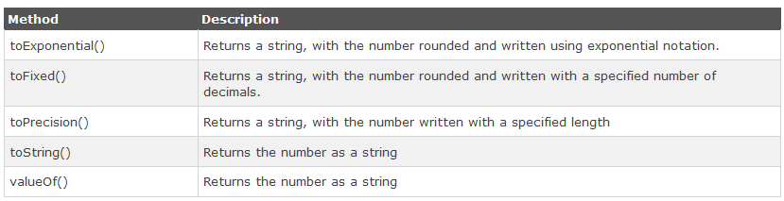
Number Methods
Converting variables to numbers:
The Number() method
The parseInt() method
The parseFloat() method

Slide 35
JavaScript Math
Math.random(); // returns a random number
Math.min(0, 150, 30, 20, -8); // returns -8
Math.max(0, 150, 30, 20, -8); // returns 150
Math.round(4.7); // returns 5
Math.ceil(4.4); // returns 5
Math.floor(4.7); // returns 4

Slide 36
JavaScript Date
new Date()
new Date(milliseconds)
new Date(dateString)
new Date(year, month, day, hours, minutes, seconds, milliseconds)
toUTCString();
toDateString();

Slide 37
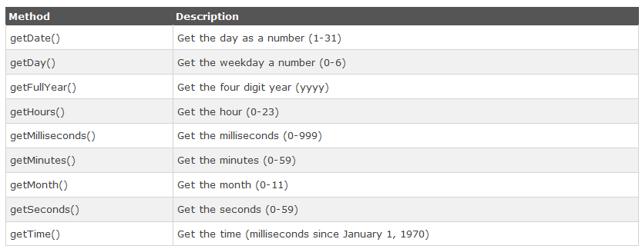
JavaScript Date Methods

Slide 38
JavaScript Arrays
var array-name = [item1, item2, ...];
var index; var fruits = ["Banana", "Orange", "Apple", "Mango"]; for (index = 0; index < fruits.length; ++index) { text += fruits[index]; }

Slide 39
JavaScript Array Methods
var fruits = ["Banana", "Orange","Apple", "Mango"];
Converting array as Strings → fruits.valueOf(), fruits.toString(), fruits.join(“*”)
Removes the last element → fruits.pop();
Adds a new element → fruits.push("Kiwi");
Shifting elements → fruits.shift(); // remove first element
Unshifting elements → fruits.unshift("Lemon"); // add lemon at the beginning
delete an element → delete fruits[0];
Splicing an array → fruits.splice(2, 0, "Lemon", "Kiwi"); // add two elements starting from 2 and remove 0 elements

Slide 40
JavaScript Array Methods
Sorting an array → fruits.sort(); // Sorts the elements of fruits
Reversing an array → fruits.reverse(); // Reverses the order of the elements
Slicing an array → fruits.slice(1,3);
Concatenating arrays → var myGirls = ["Cecilie", "Lone"]; var myBoys = ["Emil", "Tobias","Linus"]; var myChildren = myGirls.concat(myBoys);

Slide 41
JavaScript Objects
In JavaScript, objects are data (variables), with properties and methods.
In JavaScript you can also create your own objects.
This example creates an object called "person", and adds four properties to it:
Example
var person = {firstName:"John", lastName:"Doe", age:50, eyeColor:"blue"};
Accessing Object Properties
name = person.lastName; name = person["lastName"]; Accessing Object Methods
name = person.fullName();

Slide 42
JavaScript Scope
Local JavaScript Variables
Variables declared within a JavaScript function, become LOCAL to the function.
Local variables have local scope: They can only be accessed within the function.
Example
// code here can not use carName function myFunction() { var carName = "Volvo"; // code here can use carName }
Global JavaScript Variables
A variable declared outside a function, becomes GLOBAL.
A global variable has global scope: All scripts and functions on a web page can access it.
Example
var carName = " Volvo"; // code here can use carName function myFunction() { // code here can use carName }

Slide 43
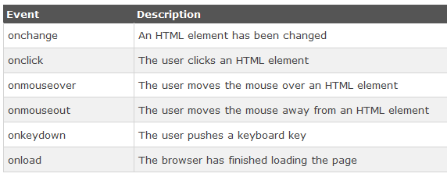
JavaScript Events
JavaScript can react to these HTML events:
An HTML web page has finished loading
An HTML input field was changed
An HTML button was clicked

Slide 44
JavaScript Events
With single quotes:
<element event='some JavaScript'>
With double quotes:
<element event="some JavaScript">
Examples:
<!DOCTYPE html>
<html>
<body>
<button onclick="document.getElementById('demo').innerHTML=Date()">The time is?</button>
<p id="demo"></p>
</body>
</html>

Slide 45
JavaScript Conditional Statement
Syntax
if (condition1) { block of code to be executed if condition1 is true } else if (condition2) { block of code to be executed if the condition1 is false and condition2 is true } else { block of code to be executed if the condition1 is false and condition2 is false }

Slide 46
JavaScript for Loop
for (initialization; condition; increment/decrement) { code block to be executed }
var i;
for (i = 0; i < 5; i++) {
document.write("The number is " + i + "<br>”);
}

Slide 47
JavaScript while Loop
while (condition) { code block to be executed }
while (i < 10) { document.write("The number is " + i); i++; }

Slide 48
JavaScript Form Validation
HTML form validation can be done by JavaScript.
If a form field (fname) is empty, this function alerts a message, and returns false, to prevent the form from being submitted:
JavaScript Example
function validateForm() { var x = document.forms["myForm"]["fname"].value; if (x == "") { alert("Name must be filled out"); return false; } }

Slide 49
JavaScript Form Validation
<!DOCTYPE html>
<html>
<head>
<script>
function validateForm() {
var x = document.forms["myForm"]["fname"].value;
if (x == "") {
alert("Name must be filled out");
return false;}}
</script>
</head>
<body>
<form name="myForm" action="/action_page.php"
onsubmit="return validateForm()" method="post">
Name: <input type="text" name="fname">
<input type="submit" value="Submit">
</form>
</body>
</html>

Slide 50
JavaScript Can Validate Numeric Input
<!DOCTYPE html>
<html>
<body>
<h2>JavaScript Can Validate Input</h2>
<p>Please input a number between 1 and 10:</p>
<input id="numb">
<button type="button" onclick="myFunction()">Submit</button>
<p id="demo"></p>
<script>
function myFunction() {
var x, text;
x = document.getElementById("numb").value;
if (isNaN(x) || x < 1 || x > 10) {
text = "Input not valid";
} else {text = "Input OK";}
document.getElementById("demo").innerHTML = text;}
</script>
</body>
</html>

Slide 51
Assignment (Optional)
Create a web-based calculator using JavaScript and other necessary tools.
Submission Deadline: Next Lab
Email to mahamudul@ewubd.edu mention Your student ID in the subject line
Eloquent Javascript second edition, Marjin Haverbeke

Slide 52
Reference
https://www.javascript.com/
https://www.tutorialspoint.com/javascript

